Slide 1
The Influence of Guided Mindfulness-Meditation on Attentional Efficiencies
Luke Sackett

Slide 2
Introduction:
What is attention?
Attention can be defined as the mental process of selectively concentrating on a discrete stimulus, or a specific piece of perceived information, while ignoring other perceivable information.

Slide 3
Introduction:
The Components of Attention:
Attention has three main components:
(1) Alerting: the ability to achieve and maintain a state of high sensitivity to sensory information.
(2) Orienting: the ability to select discrete sensory information
(3) Executive Control: the mechanism involved in resolving conflict within incoming sensory information

Slide 4
Introduction:
Default-Mode Network:
a network of brain areas that support self-referential processing which correlates heavily with the state of mind-wandering

Slide 5
Introduction:
What is Meditation?
a practice where an individual uses a technique – such as mindfulness, or focusing the mind on a particular object, thought or activity – to train attention and awareness, and achieve a mentally clear and emotionally calm and stable state.

Slide 6
Hypothesis:
If High School student participants engage in ten classes of guided Mindfulness-Meditation training throughout two weeks, their ability to use the three components of attention will improve.

Slide 7
Meditation training can improve aspects of attention and it is specifically suggested that an enhanced sustained-attention ability can be linked to long-term meditation practice.
Literature Review:
Maclean, K. A., Ferrer, E., Aichele, S. R., Bridwell, D. A., Zanesco, A. P., Jacobs, T. L., . . . Saron, C. D. (2010). Intensive Meditation Training Improves Perceptual Discrimination and Sustained Attention. Psychological Science, 21(6), 829-839. doi:10.1177/0956797610371339

Slide 8
Literature Review:
Maclean, K. A., Ferrer, E., Aichele, S. R., Bridwell, D. A., Zanesco, A. P., Jacobs, T. L., . . . Saron, C. D. (2010). Intensive Meditation Training Improves Perceptual Discrimination and Sustained Attention. Psychological Science, 21(6), 829-839. doi:10.1177/0956797610371339

Slide 9
Regular meditation resulted in less activation of the posterior-cingulate cortex, as well as the superior, middle and medial-temporal gyri and uncus which all constitute the default-mode network.
Literature Review:
Brewer, J. A., Worhunsky, P. D., Gray, J. R., Tang, Y., Weber, J., & Kober, H. (2011). Meditation experience is associated with differences in default mode network activity and connectivity. Proceedings of the National Academy of Sciences, 108(50), 20254-20259. doi:10.1073/pnas.1112029108

Slide 10
Relative to the control group,
mindfulness training led to less probe-caught mind wandering, self-caught mind wandering and retrospectively self-reported
mind wandering during testing.
Literature Review:
Mrazek, M. D., Franklin, M. S., Phillips, D. T., Baird, B., & Schooler, J. W. (2013). Mindfulness Training Improves Working Memory Capacity and GRE Performance While Reducing Mind Wandering. Psychological Science, 24(5), 776–781. doi: 10.1177/0956797612459659

Slide 11
The experimental-group session interaction was significant for the executive network, indicating that the before vs. after difference in the conflict resolution score was significant only for the trained group.
Literature Review:
Tang, Y. Y. (2014). Short-Term Meditation Intervention Improves Self-Regulation and Academic Performance. Journal of Child and Adolescent Behaviour, 02(04). doi: 10.4172/2375-4494.1000154

Slide 12
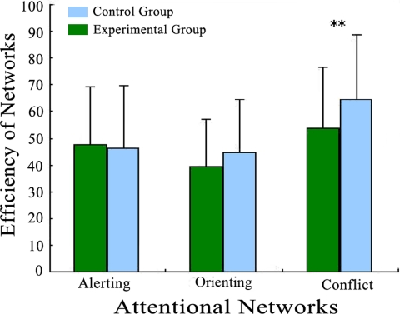
Literature Review:
Tang, Y. Y. (2014). Short-Term Meditation Intervention Improves Self-Regulation and Academic Performance. Journal of Child and Adolescent Behaviour, 02(04). doi: 10.4172/2375-4494.1000154

Slide 13
Methodology:
Materials:
Computers
A Quiet Space
A Place to Sit
Attentional Network Test (ANT)
Guided-Meditation archive: Declutter the Mind

Slide 14
Methodology:
Participants underwent two-weeks of Mindfulness-Meditation training instruction through pre-recorded guided meditation.
There were ten twenty-minute sessions throughout these two weeks.
Weekends were not included in the study.

Slide 15
Methodology:
Participants will be measured using the Attentional Network Test (ANT) which measures Alerting, Orienting and Executive Control.
During the test, three things happen:
1. A cue is shown (*)
2.Five arrows (or one arrow) are presented at either the Top or the Bottom of the computer screen
(<<<<<) or (>>>>>) or (>><>>) or (<<><<) or (>) or (<)
3. Subjects are required to indicate the direction of the central arrow of the five.

Slide 16
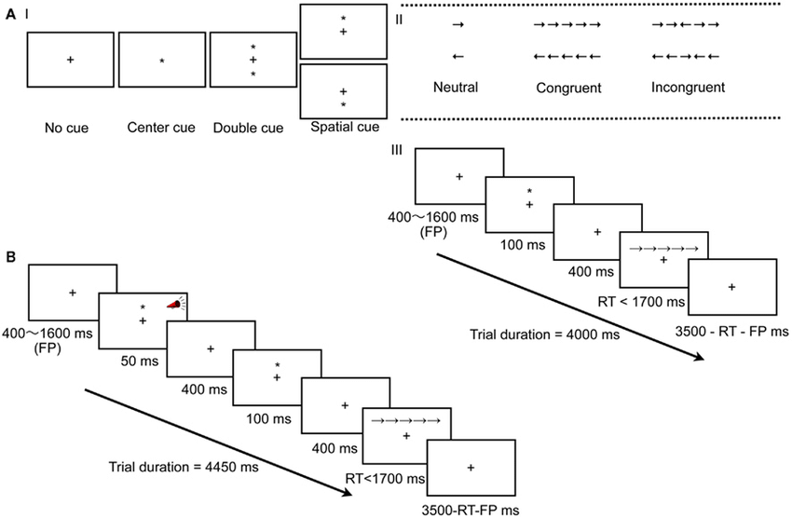
Methodology:

Slide 17
Methodology:

Slide 18
Methodology:
Each network is assessed via reaction times (rts).
Alerting: the difference of mean rts with Double Cue conditions and No Cue conditions
Orienting: the difference of mean rts with Spatial Cue conditions and Center Cue conditions
Executive control (conflict resolution): the difference of mean rts with Congruent conditions from Incongruent conditions.

Slide 19
Results
I found no statistically significant differences in efficiency scores after guided-meditation practice in contrast with their initial results prior to the regimen.

Slide 20
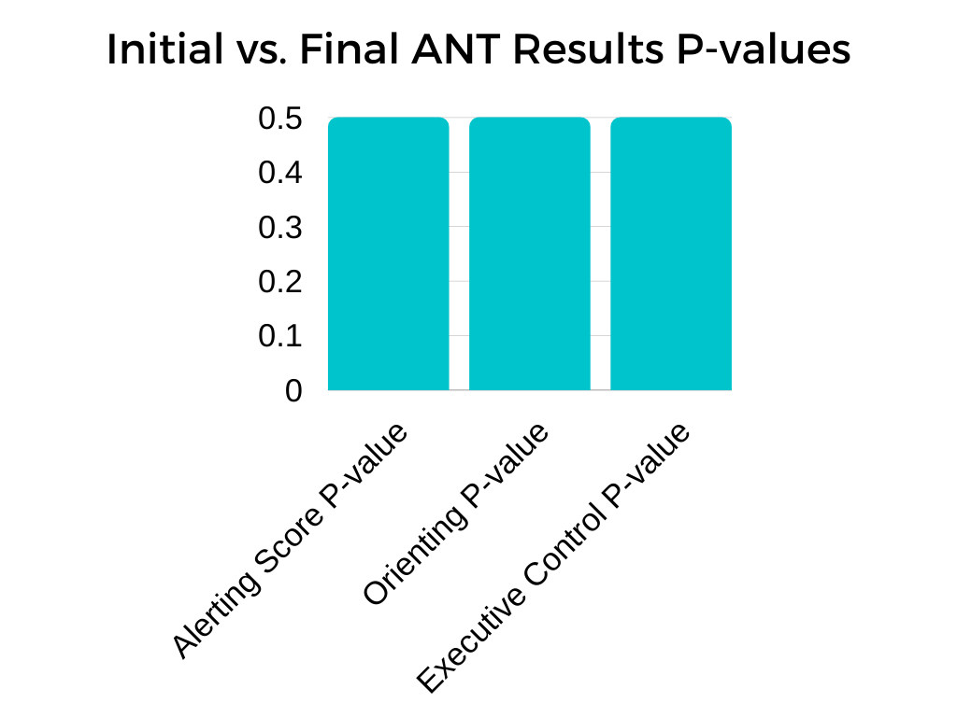
Results

Slide 21
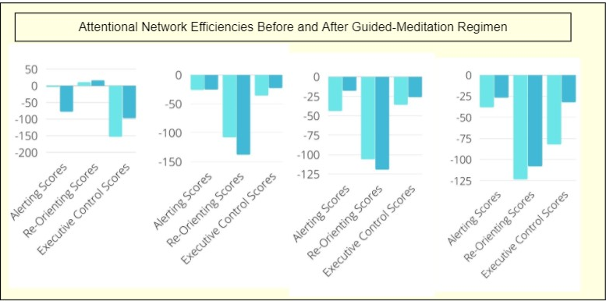
Discussion

Slide 22
Conclusion
There was no statistical significance towards the hypothesis that a short-term guided mindfulness-meditation influences network efficiencies in a manner where scores improve.

Slide 23
Future Plans:
Lengthened meditation-training periods could be used to decrease variability
Larger sample-sizes could be used to decrease variability
More intense guided-meditation regimens could also be used

